Slide 1
Angular frontend developer
HTML5 Essentials

Slide 2
Agenda
Building and Validating HTML5 Pages
HTML Headings
HTML Paragraphs
HTML Links
HTML Images
HTML Elements
Nested HTML Elements
Empty HTML Elements
HTML Attributes
Accessible Web
Validating Your Site
Hosting Your Site
Demo

Slide 3
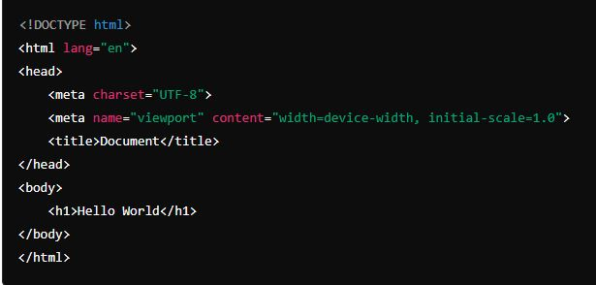
Building and Validating HTML5 Pages
Creating a Basic HTML Template:
Open VS Code and create a new file with the .html extension.
Basic structure of an HTML document
Saving the file and opening it in a browser to see the result.

Slide 4
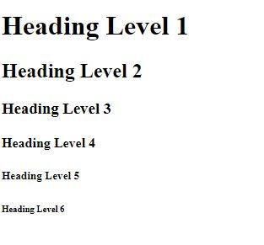
HTML Headings
HTML headings are used to define the structure and outline of a web page. They help in creating a hierarchy of content and are important for both users and search engines.
There are six levels of HTML headings, ranging from <h1> to <h6>, with <h1> being the highest (most important) level and <h6> the least.
Example:
<h1>Heading Level 1</h1>
<h2>Heading Level 2</h2>
<h3>Heading Level 3</h3>
<h4>Heading Level 4</h4>
<h5>Heading Level 5</h5>
<h6>Heading Level 6</h6>

Slide 5
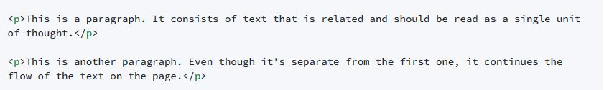
HTML Paragraphs
Paragraphs are defined using the <p> tag. This tag tells the web browser to display a block of text as a paragraph, typically with a line break before and after it to separate it from other content on the page.

Slide 6
HTML Links
Links, also known as hyperlinks, are elements that allow users to navigate from one web page to another or to a different section of the same page.
They are defined using the <a> tag, which stands for "anchor.“
<a href="url">link text</a>
<a>: The anchor tag that defines the hyperlink.
href: The attribute that specifies the URL (address) of the page or file that the link points to.
link text: The text that is visible to the user and that, when clicked, will take the user to the specified URL.

Slide 7
Examples of HTML Links
Link to an External Website:
<a href="https://www.example.com">Visit Example.com</a>
Link to a Different Page on the Same Site:
<a href="/about.html">About Us</a>
Link to a Specific Section on the Same Page:
<h2 id="contact">Contact Us</h2>
<a href="#contact">Go to Contact Section</a>
Link to a File or Download:
<a href="files/report.pdf">Download Report (PDF)</a>
Link with a Target Attribute:
<a href="https://www.example.com" target="_blank">Visit Example.com (opens in a new tab)</a>

Slide 8
HTML Images
Images are inserted using the <img> tag, which is an empty tag (meaning it contains attributes only and does not have a closing tag).
The <img> tag requires at least two attributes to function correctly: src (source) and alt (alternative text).
<img src="url/to/image.jpg" alt="Description of the image">
src: Specifies the path to the image file. This can be a relative URL (for images stored on the same server as the HTML file) or an absolute URL (for images hosted on external servers).
alt: Provides alternative text that describes the image. This text is displayed if the image cannot be loaded and is also important for accessibility, as screen readers will read this text to users who cannot see the image.

Slide 9
HTML Elements
Elements are the building blocks of web pages. They are represented by tags, which are keywords surrounded by angle brackets, like <html>.
These elements can define various types of content, such as headings, paragraphs, links, images, lists, forms, and more.
Common HTML elements:
<html>,<head>,<title>,<body>,<h1> to <h6>,<p>,<a>,<img>,<div>,<span>,<ul> and <ol>,<li>,
<table>,<form>,<input>,<button>,<select>,<option>,<textarea>,<label>,<nav>,<header>,<footer>,
<main>,<article>,<section>,<aside>,<details>,<summary>,<figure> and <figcaption>,<blockquote>,<cite>,<pre>,<code>,<video> and <audio>,<svg>,<canvas>,<iframe>,<noscript>,<meta>

Slide 10
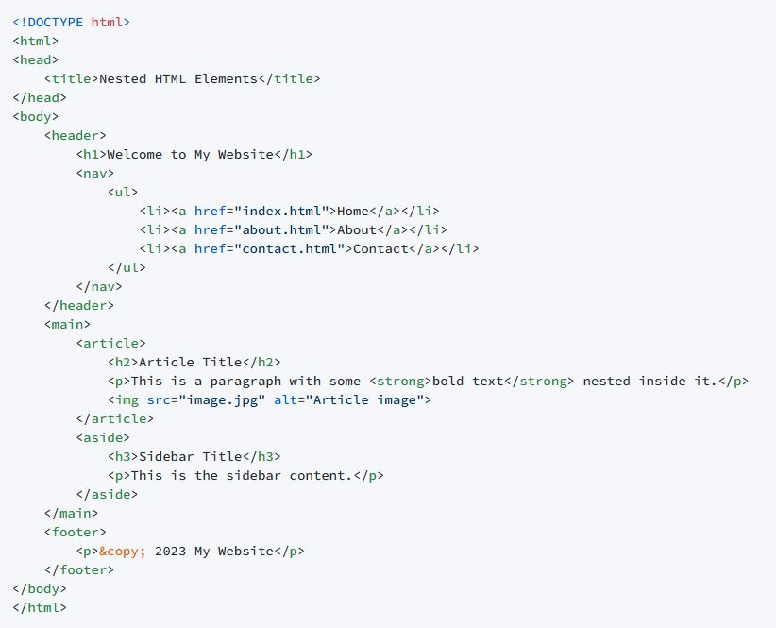
Nested HTML Elements
Nested HTML elements refer to elements that contain other elements within them. This nesting allows for the creation of complex structures and hierarchies in HTML documents.
Essentially, it's how you build the layout and content of a web page by combining different elements to represent different parts of the content.

Slide 11
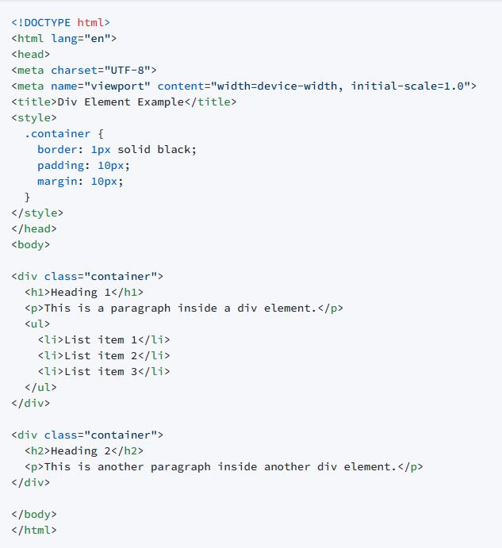
HTML Div Element
The <div> element in HTML stands for "division" and is used as a container to group and organize other elements on a webpage.
It's a block-level element, which means it takes up the full width available and has a line break before and after it.
The <div> element does not inherently represent anything, unlike other semantic HTML elements such as <article>, <section>, or <nav>.
Instead, it's a generic container that can be used to structure a document and apply CSS styles or JavaScript behavior to a group of elements.

Slide 12
Empty HTML Elements
Empty HTML elements, also known as self-closing or void elements, are elements that do not have a closing tag and do not contain any content.
They typically serve a specific purpose, such as embedding an image, creating a line break, or specifying metadata.
Common empty HTML elements:
<img>,<input>,<br>,<hr>,<link>,<meta>,<area>,<base>,<col>,
<embed>,<param>,<source>,<track>,<wbr>

Slide 13
HTML Attributes
HTML attributes provide additional information about HTML elements and are used to modify their behavior or appearance.
They are specified in the opening tag of an element and consist of a name and a value, separated by an equals sign (=). The value is typically enclosed in double quotes ("), but single quotes (') can also be used in some cases.

Slide 14
Common HTML attributes
id: Specifies a unique identifier for an element within a document.
Example: <div id="main-content"></div>
class: Assigns one or more classnames to an element for styling purposes with CSS or for scripting purposes with JavaScript.
Example: <p class="important">This is important text.</p>
style: Applies inline CSS styles to an element.
Example: <h1 style="color: blue; text-align: center;">Heading</h1>
href: Specifies the URL of a page or the destination of a hyperlink.
Example: <a href="https://www.example.com">Visit Example.com</a>
src: Specifies the source of an image or the address of an embedded resource, such as a media file.
Example: <img src="image.jpg" alt="Description">
alt: Provides alternative text for an image, which is displayed if the image cannot be loaded and is also important for accessibility.
Example: <img src="image.jpg" alt="Description of the image">

Slide 15
Common HTML attributes
title: Specifies extra information about an element, which is often displayed as a tooltip when the mouse hovers over the element.
Example: <abbr title="Hypertext Markup Language">HTML</abbr>
lang: Specifies the language of the content in an element.
Example: <p lang="es">Este es un párrafo en español.</p>
dir: Specifies the direction of the text (left-to-right or right-to-left).
Example: <p dir="rtl">هذا مثال على النص من اليمين إلى اليسار.</p>
disabled: Specifies that an input element should be disabled.
Example: <input type="submit" value="Submit" disabled>
checked: Specifies that an input element of type checkbox or radio should be checked by default.
Example: <input type="radio" name="gender" value="male" checked> Male

Slide 16
Common HTML attributes
readonly: Specifies that an input field is read-only (cannot be changed by the user).
Example: <input type="text" value="Read-only value" readonly>
required: Specifies that an input field must be filled out before submitting the form.
Example: <input type="email" name="user_email" required>
type: Specifies the type of an input element (e.g., text, password, checkbox, radio, submit).
Example: <input type="password" name="user_password">
name: Specifies the name of an input element, which is used when submitting form data to a server.
Example: <input type="text" name="firstname">
value: Specifies the value of an input element or the value of a button.
Example: <input type="text" name="firstname" value="John">

Slide 17
Accessible Web
Accessible web design refers to the process of creating websites that are usable by people with disabilities.
Web accessibility means that websites, tools, and technologies are designed and developed so that people with disabilities can use them. More specifically, people can:
perceive, understand, navigate, and interact with the Web
contribute to the Web
Web accessibility encompasses all disabilities that affect access to the Web, including:
auditory
cognitive
neurological
physical
speech
visual
The goal of accessible web design is to remove barriers and allow as many users as possible to access and engage with website content.

Slide 18
Web accessibility
Web accessibility also benefits people without disabilities, for example:
people using mobile phones, smart watches, smart TVs, and other devices with small screens, different input modes, etc.
older people with changing abilities due to ageing
people with “temporary disabilities” such as a broken arm or lost glasses
people with “situational limitations” such as in bright sunlight or in an environment where they cannot listen to audio
people using a slow Internet connection, or who have limited or expensive bandwidth

Slide 19
Validating Your Site
Validating your website is an important step in ensuring that your web pages are correctly constructed and free from HTML or CSS errors that could cause display or functional issues across different browsers and devices.
Validation helps in maintaining a high standard of quality and adherence to web standards, which can improve your site's performance and accessibility.
HTML Validation
Use the W3C Markup Validation Service:
Go to the W3C Markup Validation Service at https://validator.w3.org/.
Enter the URL of your web page, upload an HTML file, or directly input HTML code to validate.
The validator will check your HTML code against the W3C standards and return a report of any errors or warnings.
Fix the Errors:
Carefully review the validation report.
Correct any errors or warnings that the validator has identified.
Common issues include missing or misplaced tags, incorrect attribute usage, and deprecated HTML elements.
Re-validate:
After making corrections, re-validate your HTML to ensure that all issues have been resolved.

Slide 20
Hosting Your Site
Hosting your site means making it available on the internet so that users can access it.
Steps involved in hosting a website:
Choose a Web Host: Select a web hosting provider that suits your needs. Consider factors like cost, reliability, customer support, and the features offered.
Register a Domain Name: If you haven't already, register a domain name for your website. This is your website's address on the internet (e.g., www.yourwebsite.com).
Set Up Hosting: Purchase a hosting plan and set up your account with the hosting provider. This usually involves creating a hosting package and configuring the domain name to point to your hosting account.
Upload Your Website: Use an FTP (File Transfer Protocol) client or the hosting provider's file management system to upload your website files to the server.
Configure Email and Databases: If needed, set up email accounts and databases associated with your domain.
Test Your Site: Once your site is uploaded, test it thoroughly to make sure all links, forms, and other functions work as expected.
Launch Your Site: After testing, your site is ready to go live. Make sure it's accessible to the public and that all content is up to date.

Slide 21
Demo
Setting up a demo mean creating a separate instance of your site for demonstration purposes, such as for client presentations or testing new features.
How you might set up a demo:
Duplicate Your Site: Create a copy of your website files and database (if applicable).
Set Up a Subdomain or Separate Directory: Use a subdomain (e.g., demo.yourwebsite.com) or a separate directory (e.g., yourwebsite.com/demo) to host the demo version.
Configure the Demo Environment: Make any necessary configuration changes to the demo site, such as disabling e-commerce functionality or changing contact information.
Upload and Test: Upload the demo site to the server and test it to ensure it works correctly in the demo environment.
Provide Access: Share the demo site link with stakeholders or clients, and provide any necessary login credentials or instructions for use.
Hosting and setting up a demo site can vary depending on the complexity of your site and the tools and services you're using. Always refer to your hosting provider's documentation and support resources for specific instructions tailored to your situation

Slide 22
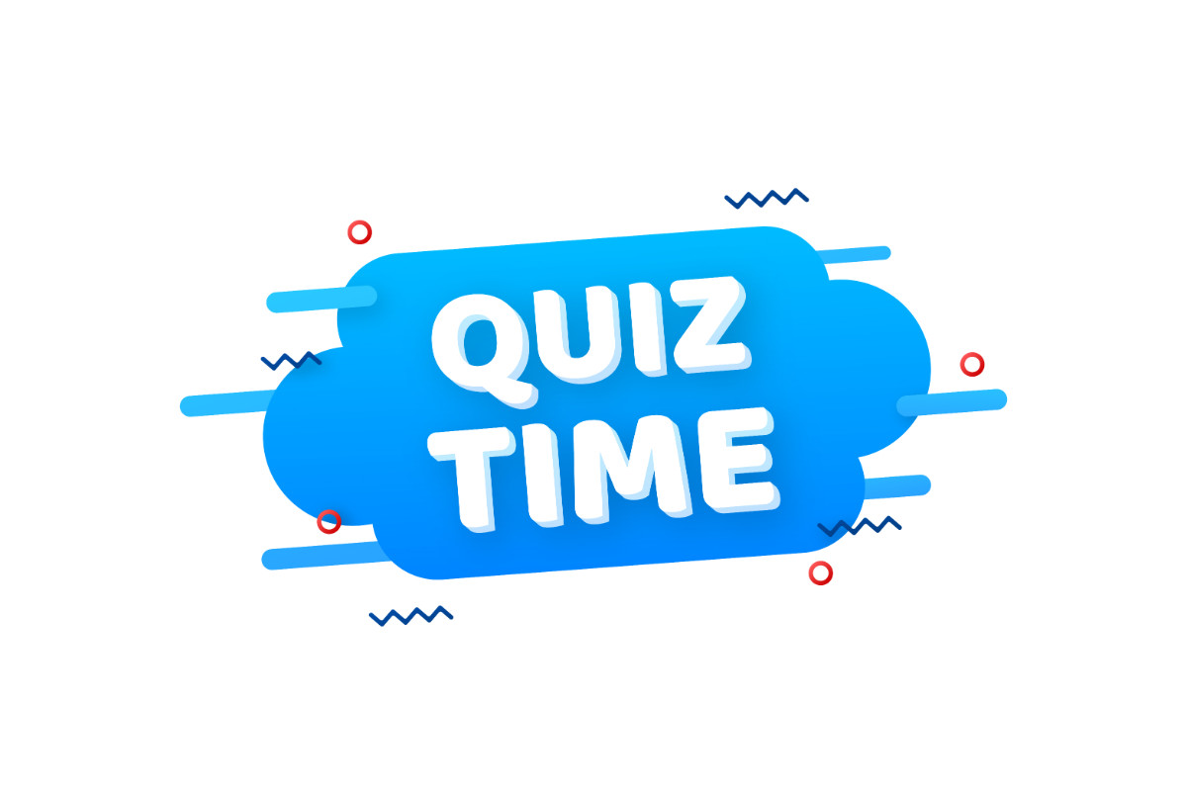
Quiz

Slide 23
Multiple Choice Questions
Which HTML5 element is used to define headings?
a) <header>
b) <h1> to <h6>
c) <heading>
d) <title>
2) What is the purpose of the <p> element?
a) To define a paragraph
b) To define a header
c) To define a list
d) To define a link
3) What is the correct way to nest a heading within a paragraph?
a) <p><h1>This is a heading</h1></p>
b) It is not possible to nest a heading within a paragraph.
c) <p><strong>This is a heading</strong></p>
d) <h1><p>This is a paragraph</p></h1>

Slide 24
Assignment
True or False Questions:
The <h1> element is the largest heading.
You can use multiple <p> elements within a single paragraph.
The <div> element is a block-level element.
It is recommended to use the <center> element for centering content.
A hosting site is essential for viewing an HTML page online.

Slide 25

Questions and Answers

Slide 26
Extra Resources
HTML Tutorial (w3schools.com)
HTML5 Tutorial (tutorialspoint.com)
HTML5 | Introduction - GeeksforGeeks
Introduction to HTML5 | Coursera

